Slide 1
ER Design issues

Slide 2
The basic design issues of an ER database schema
Use of Entity Set vs Attributes
  The use of an entity set or attribute depends on the structure of the real-world enterprise that is being modelled and the semantics associated with its attributes.
  It leads to a mistake when the user use the primary key of an entity set as an attribute of another entity set.
  Also, the primary key attributes are implicit in the relationship set, but we designate it in the relationship sets.

Slide 3
Use of Entity Set vs. Relationship Sets
It is difficult to examine if an object can be best expressed by an entity set or relationship set.
To understand and determine the right use, the user need to designate a relationship set for describing an action that occurs in-between the entities.
If there is a requirement of representing the object as a relationship set, then its better not to mix it with the entity set.

Slide 4
Use of Binary vs n-ary Relationship Sets
Generally, the relationships described in the databases are binary relationships.
However, non-binary relationships can be represented by several binary relationships.
For example, we can create and represent a ternary relationship 'parent' that may relate to a child, his father, as well as his mother.
Such relationship can also be represented by two binary relationships i.e, mother and father, that may relate to their child. Thus, it is possible to represent a non-binary relationship by a set of distinct binary relationships.

Slide 5
Placing Relationship Attributes
The cardinality ratios can become an affective measure in the placement of the relationship attributes.
So, it is better to associate the attributes of one-to-one or one-to-many relationship sets with any participating entity sets, instead of any relationship set.
The decision of placing the specified attribute as a relationship or entity attribute should possess the charactestics of the real world enterprise that is being modelled.

Slide 6
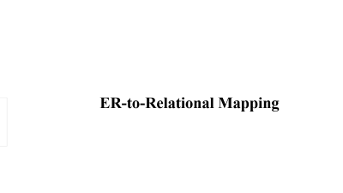

ER-to-Relational Mapping

Slide 7
ER-to-Relational Mapping Algorithm
Step 1: Mapping of Regular Entity Types
Step 2: Mapping of Weak Entity Types
Step 3: Mapping of Binary 1:1 Relation Types
Step 4: Mapping of Binary 1:N Relationship Types.
Step 5: Mapping of Binary M:N Relationship Types.
Step 6: Mapping of Multivalued attributes.
Step 7: Mapping of N-ary Relationship Types.

Slide 8
Convert Strong Entities to Tables
  Each strong entity in the ER diagram becomes a separate table in the relational model.
  The primary key (PK) of the entity remains the primary key of the table.
  All attributes of the entity become columns in the table.
Convert Weak Entities to Tables
  A weak entity does not have a primary key of its own.
  The primary key of the strong entity it depends on is added as a foreign key.
  A composite primary key is formed using the weak entity's partial key and the foreign key.

Slide 9
One-to-One (1:1) Relationship
  Choose one table to store the foreign key of the other.
  If total participation exists, the foreign key should be NOT NULL.
One-to-Many (1:M) Relationship
  The primary key of the "one" side becomes a foreign key in the "many" side.
Many-to-Many (M:M) Relationship
  A new table (junction table) is created with two foreign keys.

Slide 10
Convert Multivalued Attributes
  Multivalued attributes need separate tables.
  The new table includes:
    The primary key of the original entity.
    The multivalued attribute as a separate column.
    A composite primary key (Entity PK + Attribute).
Convert Generalization/Specialization
Single Table Approach
    A single table stores all attributes.
    A discriminator column is used to differentiate subclasses.

Slide 11
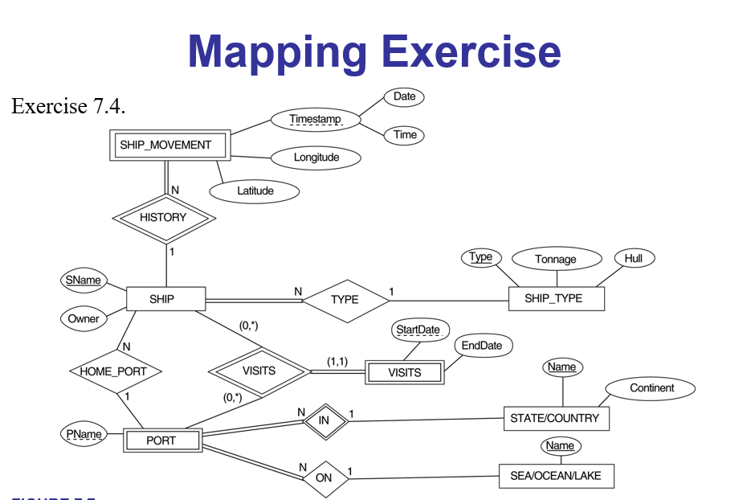

Slide 12
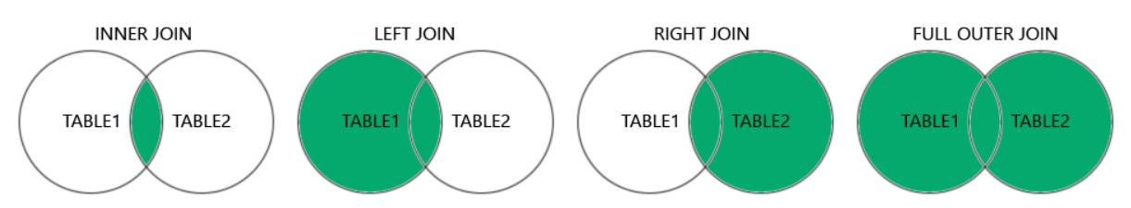
SQL Join Operations
(INNER) JOIN: Returns records that have matching values in both tables
LEFT (OUTER) JOIN: Returns all records from the left table, and the matched records from the right table
RIGHT (OUTER) JOIN: Returns all records from the right table, and the matched records from the left table
FULL (OUTER) JOIN: Returns all records when there is a match in either left or right table

Slide 13
Inner join
SELECT * FROM Customers
INNER JOIN Orders
ON
Customers.CustomerID = Orders.CustomerID;

Slide 14
LEFT JOIN (LEFT OUTER JOIN)
SELECT *
FROM Customers
LEFT JOIN Orders
ON Customers.CustomerID = Orders.CustomerID;

Slide 15
RIGHT JOIN (RIGHT OUTER JOIN)
SELECT *
FROM Customers
RIGHT JOIN Orders
ON Customers.CustomerID = Orders.CustomerID;

Slide 16
FULL OUTER JOIN
SELECT *
FROM Customers
FULL JOIN Orders ON
Customers.CustomerID = Orders.CustomerID;

Slide 17
Questions
Customers (CustomerID, Name, Email)
Orders (OrderID, CustomerID, Product, Price)
To retrieve customers who have made a purchase
To list all customers, even those without orders
To list all orders, including those from unknown customers
To get all customers and orders, whether they match or not

Slide 18
Q1)
SELECT Customers.Name, Orders.Product, Orders.Price
FROM Customers
INNER JOIN Orders ON Customers.CustomerID = Orders.CustomerID;
Q2) SELECT Customers.Name, Orders.Product, Orders.Price
FROM Customers
LEFT JOIN Orders ON Customers.CustomerID = Orders.CustomerID;

Slide 19
Q3)
Q4)
SELECT Customers.Name, Orders.Product, Orders.Price
FROM Customers
FULL JOIN Orders ON Customers.CustomerID = Orders.CustomerID;
SELECT Customers.Name, Orders.Product, Orders.Price
FROM Customers
RIGHT JOIN Orders ON Customers.CustomerID = Orders.CustomerID;

